Slide 1

Bacchus Project’s Progress

Slide 2



Last Meeting Result
Design
Need a new design, color combos, choice of picture
Need to learn Adobe InDesign
Outline
Need to rearrange the content list
Need to fill up the content
Content
Need to find quantitative data
Need new links for further study

Slide 3

Design
Change of Logo
Change of Color Combos
Change of Pictures and learn how to use InDesign

Slide 4

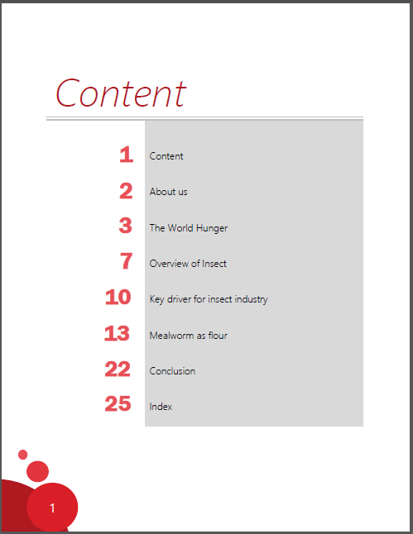
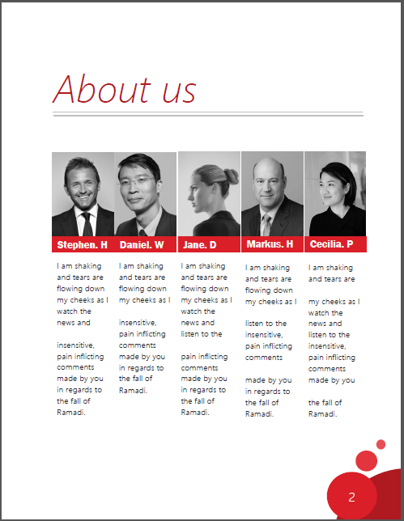
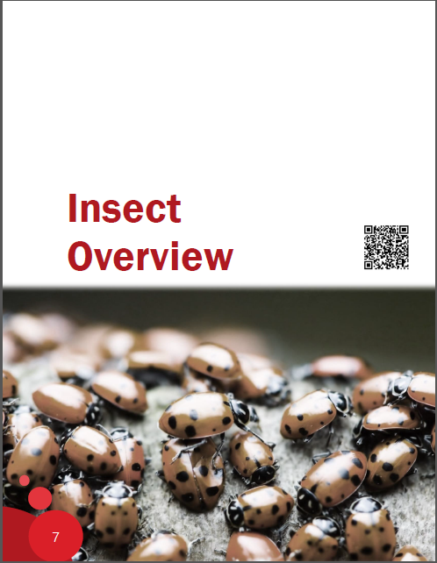
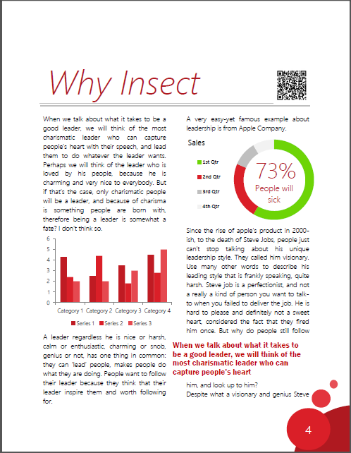
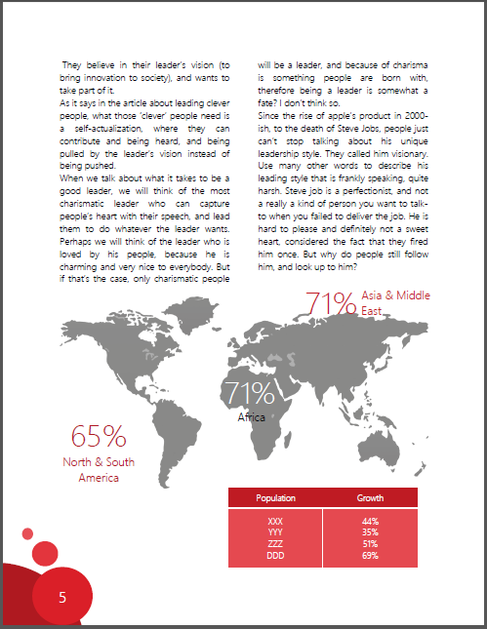
1st Option

Slide 5
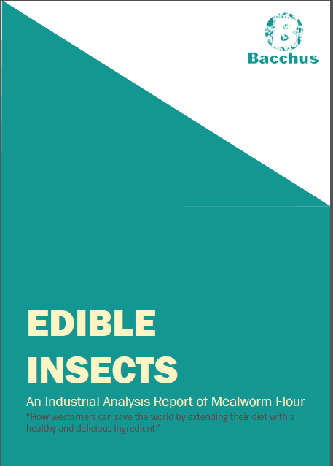
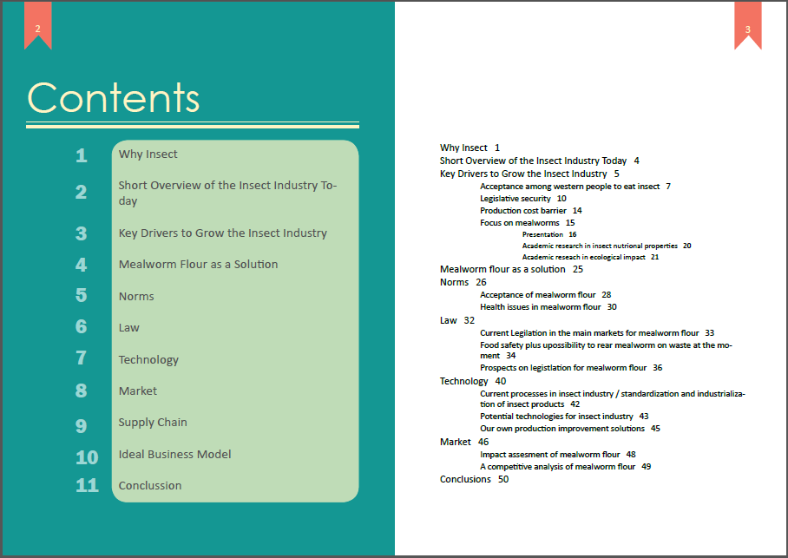

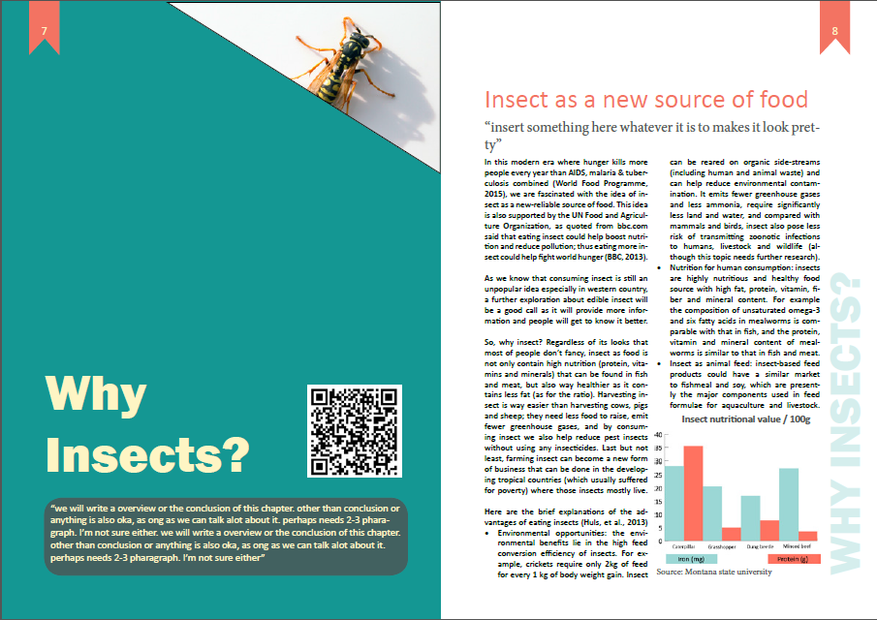
2nd Option

Slide 6
Outline
Report Overview |  | Progress (%) | What's inside
Why insect |  | 100% | Brief advantages of insect
Overview o the insect industry today |  | 50% | geographical consumption, market size, most eaten insect, insect production
Key drivers for insect industry
 | Acceptance among western people | 100% | why westerner disgust of insect
 | Legislative security | 30% | insect as novel food in EU, regulation in Belgium
 | Production cost barrier | 0%
Mealwom flour as a solution |  | 100% | why we choose mealworm, the advantages of mealworm
Norms
 | Acceptance | 0%
 | Nutritional content and health | 0%
 | Environmental impact | 0%

Slide 7
Outline
Report Overview |  | Progress (%) | What's inside
Law
 | Current legislation in the main market | 20% | Belgium acceptance on 10 insect species
 | Prospection legislation | 0%
Technology
 | Current processes in insect industry/ standardization & industrialization | 50% | study about soybean
 | Potential technologies for insect industry | 50% | study about soybean
 | Our own production improvement solution | 0%
Market
 | Impact assessment | 100% | comparation with other product in terms of consumption and price
 | A competitive analysis (5 Porter) | 0%
Supply chain |  | 20% | transparant information in production
Ideal business model |  | 20% | template on market size

Slide 8
Content
Market Size
Human Consumption
Animal Consumption

Slide 9
Content
Market Size
Human Consumption
Animal Consumption

Slide 10
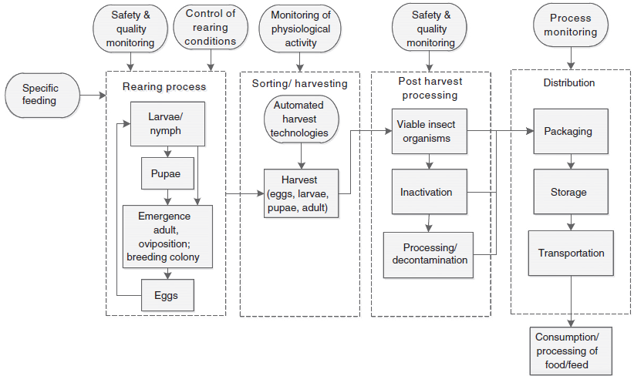
Content
Technology
“Schematic production process of food and feed derived from edible insects”
Source: Rumpold, Schluter, 2012

Slide 11

Content
Law - Acceptance
Asia 194
Europe 5
Oceania 49
Number of edible species around the world
America 545
Africa 185
Source: Rumpold, Schluter, 2012
Notes:
Do we need detail data? or is it not necessary?

